Slide 1


Slide 2


Permutations and Combinations

Slide 3
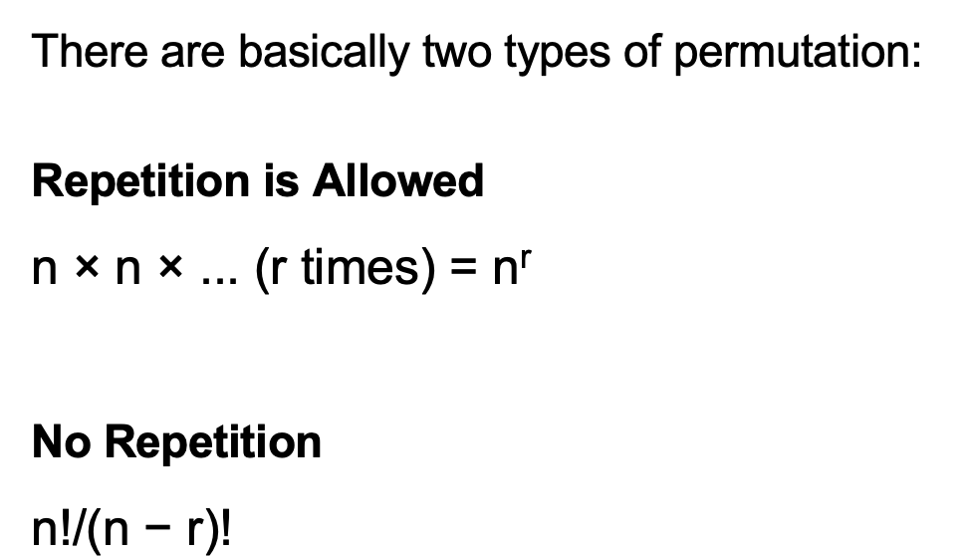
Permutations
The different arrangements of a given number of things by taking some or all at a time, are called permutations.
^{n} P_{r} = n! / (n – r)!

Slide 4
Permutations
There are basically two types of permutation:
Repetition is Allowed
n × n × ... (r times) = n^{r}
No Repetition
n!/(n − r)!

Slide 5
Combinations
Each of the different groups or selections which can be formed by taking some or all of a number of objects is called a combination.
^{n} C _{r} = n! / [ r ! x (n – r)! ]
Note:
^{n} C _{n} =1 and ^{n} C ₀ =1
^{n} C _{r=} ^{n} C _{(n-r)}

Slide 6
Question 01:
How many words can be formed by using all letters of the word 'BIHAR'?
24
60
120
720
Answer: C

Slide 7
Explanation:
The word 'BIHAR' has 5 letters and all these 5 letters are different. Total number of words that can be formed by using all these 5 letters = ⁵P₅ =5!=5! =5×4×3×2×1=120

Slide 8
Question 02:
What is the value of ¹⁰⁰P₂ ?
9801
9900
12000
12500
Answer: B

Slide 9
Explanation:
^{n} P_{r} = n! / (n – r)!
¹⁰⁰P₂ =100×99=9900

Slide 10
Question 03:
How many arrangements can be made out of the letters of the word 'ENGINEERING' ?
1440
50400
182000
277200
Answer: D

Slide 11
Explanation:
The word 'ENGINEERING' has 11 letters. But in these 11 letters, 'E' occurs 3 times,'N' occurs 3 times, 'G' occurs 2 times, 'I' occurs 2 times and rest of the letters are different. Hence, number of ways to arrange these letters
=11!/(3!)(3!)(2!)(2!)
=277200

Slide 12
Question 04:
In how many different ways can the letters of the word 'JUDGE' be arranged such that the vowels always come together?
12
24
48
None of these
Answer: C

Slide 13
Explanation:
The word 'JUDGE' has 5 letters. It has 2 vowels (UE) and these 2 vowels should always come together. Hence these 2 vowels can be grouped and considered as a single letter. That is, JDG(UE). Hence we can assume total letters as 4 and all these letters are different. Number of ways to arrange these letters =4!=4×3×2×1=24 In the 2 vowels (UE), all the vowels are different. Number of ways to arrange these vowels among themselves =2!=2×1=2 Total number of ways =24×2=48

Slide 14
Question 05:
How many 6 digit telephone numbers can be formed if each number starts with 35 and no digit appears more than once?
720
360
1420
1680
Answer: D

Slide 15
Explanation:
The first two places can only be filled by 3 and 5 respectively and there is only 1 way for doing this. Given that no digit appears more than once. Hence we have 8 digits remaining (0,1,2,4,6,7,8,9)(0,1,2,4,6,7,8,9) So, the next 4 places can be filled with the remaining 8 digits in ⁸P₄ ways. Total number of ways = ⁸P₄ =8×7×6×5=1680

Slide 16
Question 06:
An event manager has ten patterns of chairs and eight patterns of tables. In how many ways can he make a pair of table and chair?
64
80
100
110
Answer: B

Slide 17
Explanation:
He has 10 patterns of chairs and 8 patterns of tables
A chair can be selected in 10 ways. A table can be selected in 8 ways.
Hence one chair and one table can be selected in 10×810×8 ways =80 ways

Slide 18
Question 07:
25 buses are running between two places P and Q. In how many ways can a person go from P to Q and return by a different bus?
576
590
600
625
Answer: C

Slide 19
Explanation:
He can go in any of the 25 buses (25 ways).
Since he cannot come back in the same bus, he can return in 24 ways.
Total number of ways =25×24=600

Slide 20
Question 08:
A box contains 4 red, 3 white and 2 blue balls. Three balls are drawn at random. Find out the number of ways of selecting the balls of different colours?
12
24
48
60
Answer: B

Slide 21
Explanation:
1 red ball can be selected in ⁴C₁ ways. 1 white ball can be selected in ³C₁ ways. 1 blue ball can be selected in ²C₁ ways. Total number of ways = ⁴C₁ × ³C₁ × ²C₁ =4×3×2=24

Slide 22
Question 09:
A question paper has two parts P and Q, each containing 10 questions. If a student needs to choose 8 from part P and 4 from part Q, in how many ways can he do that?
1200
4800
9450
None of t Answer: C

Slide 23
Explanation:
Number of ways to choose 8 questions from part P = ¹⁰C₈
Number of ways to choose 4 questions from part Q = ¹⁰C₄
Total number of ways
= ¹⁰C₈ × ¹⁰C₄
=45×210
=9450
Notes:
.

Slide 24
Question 10:
In how many ways can 5 man draw water from 5 taps if no tap can be used more than once?
56
80
108
120
Answer: D

Slide 25
Explanation:
1st man can draw water from any of the 5 taps.
2nd man can draw water from any of the remaining 4 taps.
3rd man can draw water from any of the remaining 3 taps.
4th man can draw water from any of the remaining 2 taps.
5th man can draw water from remaining 1 tap.
Hence total number of ways =5×4×3×2×1
=120

Slide 26
Question 11:
In how many ways can three boys can be seated on five chairs?
30
60
80
120
Answer: B

Slide 27
Explanation:
There are three boys. The first boy can sit in any of the five chairs (5 ways).
Now there are 4 chairs remaining. The second boy can sit in any of the four chairs (4 ways).
Now there are 3 chairs remaining. The third boy can sit in any of the three chairs (3 ways). Hence, total number of ways in which 3 boys can be seated on 5 chairs =5×4×3 =60

Slide 28
Question 12:
In how many ways can 7 boys be seated in a circular order?
60
120
5040
720
Answer: D

Slide 29
Explanation:
Number of arrangements possible =(7−1)!=6!=6×5×4×3×2×1=720

Slide 30
Question 13:
In how many ways can a team of 5 persons be formed out of a total of 10 persons such that two particular persons should not be included in any team?
28
56
112
120
Answer: B

Slide 31
Explanation:
Two particular persons should not be included in each team. we have to select 5 persons from 10-2 = 8 persons. Hence, required number of ways = ⁸C₅
=8×7
=56

Slide 32
Question 14:
If ^{n}C₈ = ^{n}C₂₇ , what is the value of n?
22
28
35
41
Answer: C

Slide 33
Explanation:
^{n}C₈ = ^{n}C₂₇
If ^{n}C_{x} = ^{n}C_{y} then either x = y or (n-x) = y => n – 8 = 27 => n = 27 + 8 = 35

Slide 34
Question 15:
In how many ways can 10 students can be arranged in a row?
9!
6!
8!
10!
Answer: D

Slide 35
Explanation:
10 students can be arranged in a row in ¹⁰P₁₀ = 10! ways.

